Slide 1


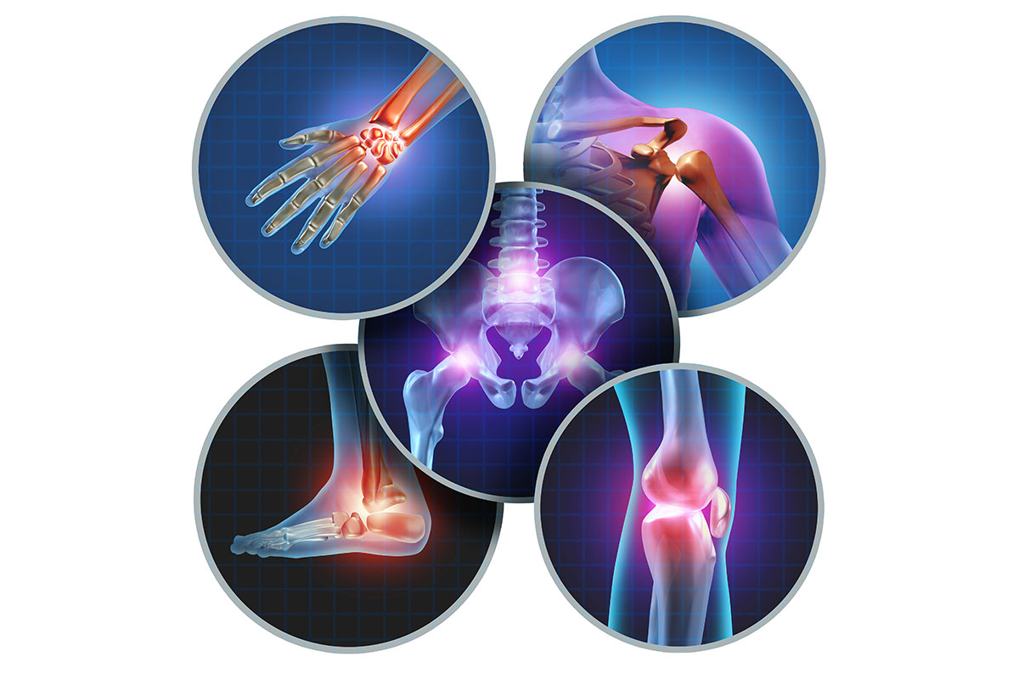
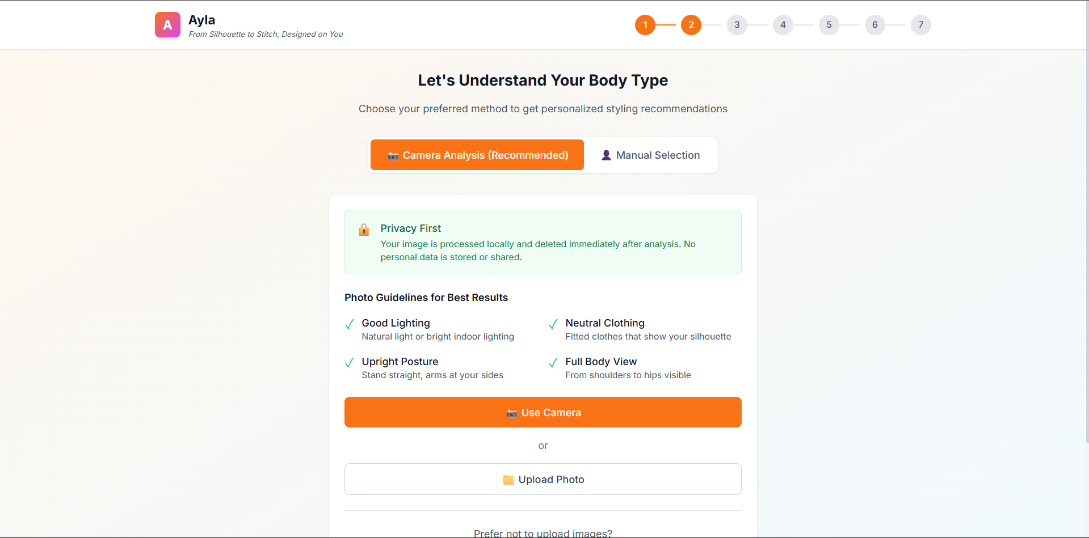

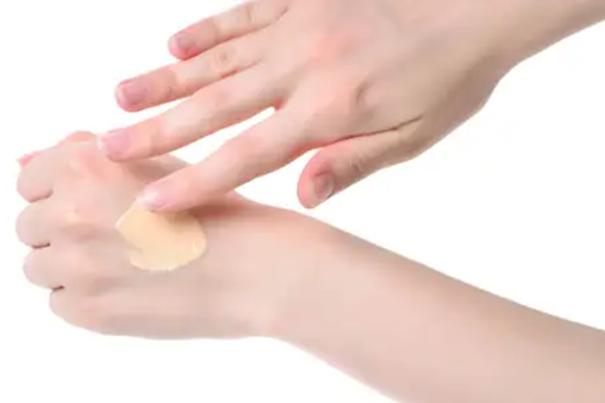
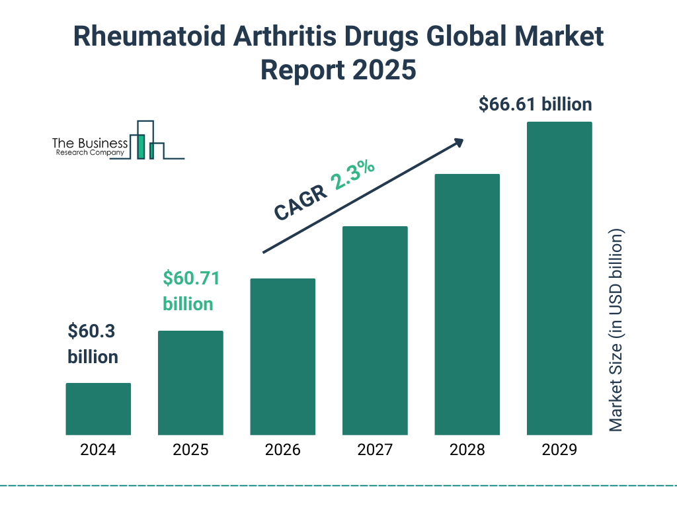




AYLA – FROM SILHOUTTE TO STICTH
DIVISION OF COMPUTER SCIENCE AND ENGINEERING
FIELD OF THE INVENTION
The present invention relates to the field of artificial intelligence, computer vision, and fashion technology, particularly to a silhouette-based digital twin system for personalized Indian ethnic wear styling and design visualization.
BACKGROUND OF THE INVENTION
Difficulty in visualizing ethnic outfit designs on individual body shapes before stitching.
Dependence on verbal descriptions, reference images, or mannequins in traditional tailoring.
Frequent mismatches in design expectations and repeated alterations.
Existing platforms lack body-specific visualization and tailor-ready design support.
OBJECTIVE
SCIENTIFIC VALIDATION
To develop an AI-based digital styling platform that helps Indian women visualize and finalize ethnic outfit designs before stitching.
RESULTS
BRIEF DESCRIPTION OF THE PRODUCT
DIGITAL STYLING SYSTEM: A mobile-based AI assistant that creates a silhouette-based digital twin for personalized Indian blouse and outfit design.
MODE OF ACTION: Generates body silhouette from image or manual input, applies rule-based styling with fabric awareness, and enables design customization and export.
COMMERCIAL VIABILITY
APPLICATIONS:
Custom ethnic wear users
Working women
Bridal and festive styling
Tailors and boutiques
UNIQUENESS : 100% plant-based, free from synthetic chemicals, making it suitable for long-term external application.
INDUSTRIES IDENTIFIED
Fashion Technology
Industry, Apparel and Garment Industry,
Tailoring and Boutique Services,
AI-based Personalization Platforms.
PRODUCT DEVELOPED
COMPARISON WITH
NATIONAL & INTERNATIONAL PRODUCTS
NATIONAL : STYLZ , zazzdrobe
INTERNATIONAL: DNA styles
COST OF THE PRODUCT
Market Price = ₹200 per bottle(100ml)
MENTOR :
Dr Anitha J
STUDENT INNOVATOR
Trina Joan Lynus (URK23CS1308)
D Jerlin Seraphina (URK23CS1004)
Jershlin Paul J (URK23CS1059)

